Slide 1
Computer Organization and Architecture (BESE-15a)
HammaD AfzaL (Ph.D)
Dept. of Computer Science
hammad.afzal@mcs.edu.pk
27/12/2010

Slide 2
External Memory From Computer Organization and Architecture William Stallings- 7th Edition

Slide 3
Types of External Memory
Magnetic Disk
RAID
Optical
CD-ROM
CD-Recordable (CD-R)
CD-R/W
DVD

Slide 4
Magnetic Disk
Disk is a circular platter constructed of non-magnetic material called the substrate.
Disk substrate coated with magnetisable material.
Substrate used to be aluminium but Now glass is used. Glass has following advantages
Improved surface uniformity
Increases reliability
Reduction in surface defects
Reduced read/write errors
Better stiffness
Better shock/damage resistance

Slide 5
Magnetic Read and Write Mechanisms
Recording & retrieval via conductive coil called a head
May be single read/write head or separate, one for read and one for write.
During read/write, head is stationary, platter rotates
Write
Current through coil produces magnetic field.
Electric Pulses sent to head
Resulting Magnetic patterns are recorded on surface below, with different patterns for positive and negative current.
Read (traditional)
Magnetic field moving relative to coil produces current in the coil.
When surface of platter passes under the head, it generates the current of same polarity as the one recorded previously.
Coil is the same for read and write.
Used in Floppy Disk systems.

Slide 6
Read and Write Mechanisms (No Details required)
Read (contemporary)
Separate read head, positioned close to write head.
Read Head consists of partially shielded magneto resistive (MR) sensor
Electrical resistance depends on the direction of magnetization of the medium moving under it.
By passing a current through the MR sensor, resistance changes are detected as voltage signals.
High frequency operation
Higher storage density and speed

Slide 7
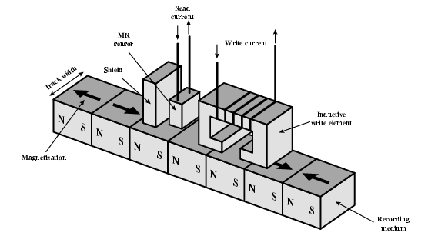
Inductive Write MR Read

Slide 8
Data Organization and Formatting
Head
is a relatively small device capable of reading from or writing to a portion of the platter rotating beneath it.
Thus, data is organized on concentric rings or tracks on platter called tracks.
Each track has same width as head.
There are thousands of tracks.
Tracks divided into sectors
Minimum block size is one sector
May have more than one sector per block

Slide 9
Data Organization and Formatting
Gaps
Gaps between tracks
Reduce gap to increase capacity
Same number of bits per track (variable packing density)
Constant angular velocity
Data is transferred to and from the disk in sectors.
Hundreds of sectors per track.
Sectors may be fixed or variable length.
In contemporary systems, fixed length sectors with 512 bytes.

Slide 10
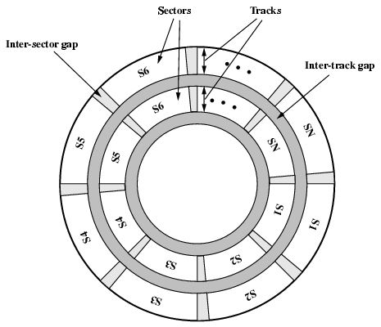
Disk Data Layout

Slide 11
Disk Velocity
Bit near centre of rotating disk passes fixed point slower than bit on outer side of disk.
Mechanism is required to compensate for the variation in speed so that the head can read all the bits at same rate.
Increase spacing between bits in different tracks.
Rotate disk at constant angular velocity (CAV)

Slide 12
Disk Velocity
Rotate disk at constant angular velocity (CAV)
Gives pie shaped sectors and concentric tracks
Individual tracks and sectors addressable.
Move head to given track and wait for given sector
Waste of space on outer tracks
Lower data density
Multiple Zone Recording.
Can use zones to increase capacity
Each zone has fixed bits per track
More complex circuitry

Slide 13
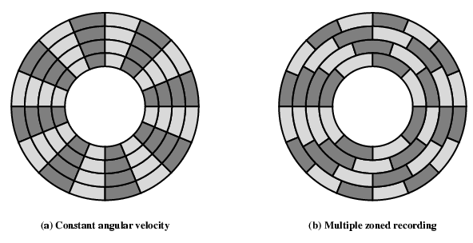
Disk Layout Methods Diagram

Slide 14
Finding Sectors
Must be able to identify start of track and sector.
Control Data recorded on Disk: Disk is formatted with extra data used only by disk drive and not accessible to the user.
Format disk
Additional information not available to user
Marks tracks and sectors

Slide 15
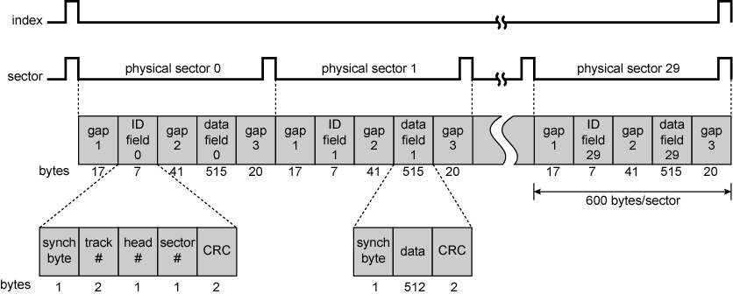
Winchester Disk Format Seagate ST506

Slide 16
Winchester Disk Format Seagate ST506
Diagram from previous slide:
Details of the fields are in book.

Slide 17
Physical Characteristics
Head Motion
Fixed (rare) or movable head
Disk Portability
Removable or fixed
Sides
Single or double (usually) sided
Platters
Single or multiple platter
Head mechanism
Contact (Floppy)
Fixed gap
Flying (Winchester)

Slide 18
Fixed/Movable Head Disk
Fixed head
One read write head per track
Heads mounted on fixed ridged arm
Movable head
One read write head per side
Mounted on a movable arm

Slide 19
Removable or Not
Disk is mounted on disk drive which consists of the arm, a spindle that rotates the disk and electronics.
Removable disk
Can be removed from drive and replaced with another disk
Provides unlimited storage capacity
Easy data transfer between systems
Example: Floppy Disk
Non-removable disk
Permanently mounted in the drive. E.g. Hard disk.

Slide 20
Multiple Platter
One head per side
Heads are joined and aligned
Aligned tracks on each platter form cylinders
Data is striped by cylinder
reduces head movement
Increases speed (transfer rate)

Slide 21
Multiple Platter
Multiple platters stacked vertically a fraction of an inch apart.
Multiple arms are provided.
Movable head: One read-write head per platter surface.
Heads are joined and aligned: Thus all heads are on tracks that are on equal distance from the centre of disk.
Aligned tracks on each platter form cylinders

Slide 22
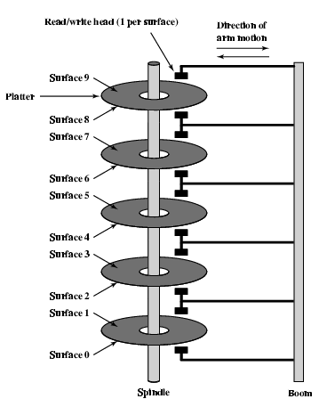
Multiple Platters

Slide 23
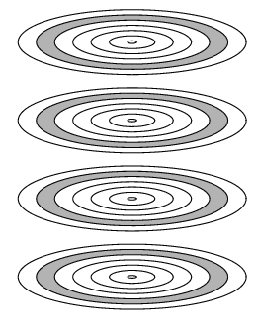
Tracks and Cylinders

Slide 24
Head Mechanism
An air gap between head and platter.
Physically in contact.

Slide 25
Floppy Disk
8”, 5.25”, 3.5”
Small capacity
Up to 1.44Mbyte (2.88M never popular)
Slow
Universal
Cheap
Obsolete?

Slide 26
Winchester Hard Disk (1)
Developed by IBM in Winchester (USA)
Sealed unit
One or more platters (disks)
Heads fly on boundary layer of air as disk spins
Very small head to disk gap
Getting more robust

Slide 27
Winchester Hard Disk (2)
Universal
Cheap
Fastest external storage
Getting larger all the time
250 Gigabyte now easily available (2006)

Slide 28
Disk Performance Parameters
I/O operation depends on
Computer System
Operating System
Nature of I/O Channel
Disk Controller Hardware

Slide 29
Disk Performance Parameters
When the disk drive operates,
Disk is rotating at constant speed
Head must be positioned on desired track and at start of sector.
Seek time:
Time it takes head to move to track position.
Electronically selecting one head on fixed head system.
Rotational Delay or Rotational Latency
Time it takes for the beginning of sector to reach the head
Access time = Seek time + Rotational Delay
Transfer time: The time required for transfer of data (read/write).
Queuing Delays
Multiple disk devices – Shared I/O Channel

Slide 30
Disk Performance Parameters
Rotational Positional Sensing (RPS)
Increased Speed: I/O Channel is freed after Seek Command.
I/O Channel reconnect once the data to be read is under the head.
RPS Miss:
If control unit of channel is busy.
Another rotation.

Slide 31
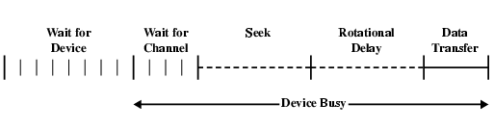
Timing of Disk I/O Transfer

Slide 32
Industrial Standard: RAID
When performance reaches an optimum, introduce parallelism.
Same for Disks: Redundant Array of Independent Disks
RAID introduced by researchers at UC Berkley.
Separate I/O requests can be handled in parallel.
Single I/O request in parallel if block of data required resides on more than one disks.
Many ways to organize Data & Redundancy for reliability.

Slide 33
Industrial Standard: RAID
7 Levels, 0 through 6.
6 levels in common use
Not a hierarchy but different design architectures with following characteristics.
Set of physical disks viewed as single logical drive by O/S
Data distributed across physical drives
Can use redundant capacity to store parity information which guarantees data recoverability in case of a disk failure.

Slide 34
RAID 0
No redundancy
Data striped across all disks
Increase speed
Multiple data requests probably not on same disk
Disks seek in parallel
A set of data is likely to be striped across multiple disks

Slide 35
RAID 1
Mirrored Disks
Data is striped across disks
2 copies of each stripe on separate disks
Read from either
Write to both
Recovery is simple
Swap faulty disk & re-mirror
No down time
Expensive

Slide 36
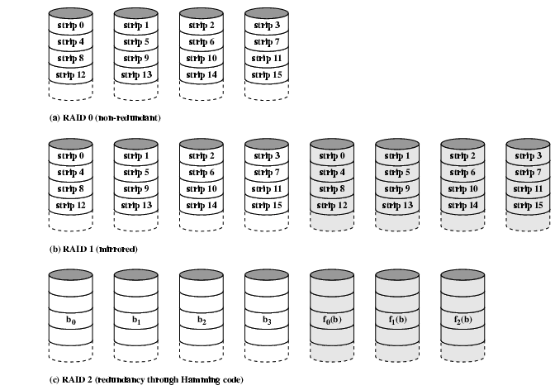
RAID 0, 1, 2

Slide 37
RAID – Scope
For further studies, refer to Book.
Only Basic theme of RAID is included in Syllabus. Details of 7 levels of RAID are out of SCOPE

Slide 38
Optical Storage CD-ROM
1983 – Most successful consumer product: Compact Disk Digital Audio System
650Mbytes giving over 70 minutes audio
Polycarbonate coated with highly reflective coat, usually aluminium
Data stored as pits. Written by high intensity Laser.
Usually dies are made, and then used to imprint on other disks.
Read by reflecting laser.
Varying intensity with smooth lands and pits.
Data Organized in Spirrals (not in Tracks)
Constant packing density.
Constant linear velocity

Slide 39
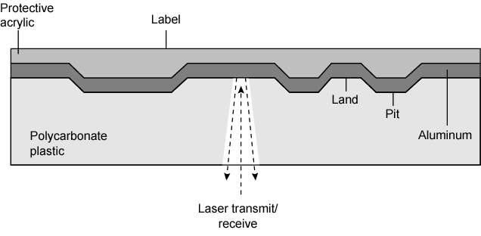
CD Operation

Slide 40
CD-ROM Drive Speeds
Audio is single speed
Constant linier velocity

Slide 41
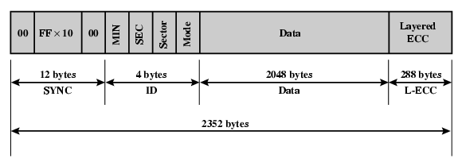
CD-ROM Format
Mode 0=blank data field
Mode 1=2048 byte data+error correction
Mode 2=2336 byte data

Slide 42
Random Access on CD-ROM
Difficult
Move head to rough position
Set correct speed
Read address
Adjust to required location
(Yawn!)

Slide 43
CD-ROM for & against
Advantages
Large capacity (?)
Easy to mass produce
Removable
Robust replication
Disadvantages
Expensive for small runs
Large access time as compared to Magnetic Disks
Read only

Slide 44
Other Optical Storage
CD-Recordable (CD-R)
WORM
Now affordable
Compatible with CD-ROM drives
Use of dye.
CD-RW
Erasable
Getting cheaper
Mostly CD-ROM drive compatible
Phase change
Material has two different reflectivity in different phase states

Slide 45
DVD - what’s in a name?
Digital Video Disk
Used to indicate a player for movies
Only plays video disks
Digital Versatile Disk
Used to indicate a computer drive
Will read computer disks and play video disks.
7 times more data than CD-ROM

Slide 46
CD & DVD
Bits are packed more closely.
Shorter distance between pits, uses laser with shorter wavelength.

Slide 47
DVD - technology
Very high capacity (4.7G per layer).
Multi-layer.
2 Layers: 8.5 GB.
Can be two sided
17 GB

Slide 48
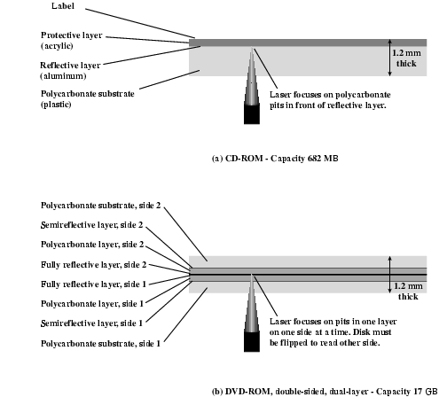
CD and DVD

Slide 49
High Definition Optical Disks
Designed for high definition videos
Much higher capacity than DVD
Shorter wavelength laser
Blue-violet range
Smaller pits
HD-DVD
15GB single side single layer
Blue-ray
Data layer closer to laser
Tighter focus, less distortion, smaller pits
25GB on single layer
Available read only (BD-ROM), Recordable once (BR-R) and re-recordable (BR-RE)

Slide 50
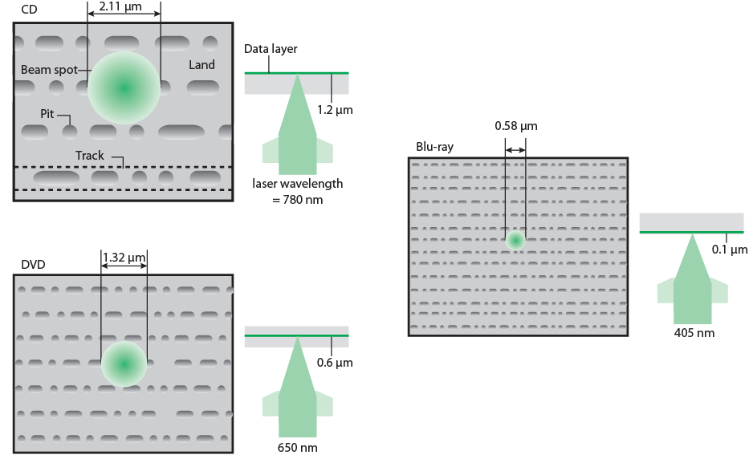
Optical Memory Characteristics

